Slide 1
Fluent BDD
a composed approach to behaviours

Slide 2
From the outside in
I make my customer happy by providing features
This keeps me in a job and pays for the stuff I want to have/do
So let’s make a feature:
Imagine we are providing a system for a
bowling alley…

Slide 3
From the outside in
Let’s look at scoring
Feature: Score Calculation

Slide 4
From the outside in
Let’s look at scoring
Feature: Score Calculation
Why do I want this feature?
So players get competitive and keep buying games,
but don’t fight about the scoring rules – so I don’t have to call the cops!

Slide 5
From the outside in
So,
Feature: Score Calculation
For players to know their score
Who is the stakeholder for this feature, and what do they want from this feature?

Slide 6
From the outside in
So,
Feature: Score Calculation
For players to know their score
As a player
I want the system to calculate my total score
Great! A feature. So now I need to implement it.
First question: how do I know when I’m done?

Slide 7
From the outside in
Feature: Score Calculation
For players to know their score
As a player, I want the system to calculate my total score
In BDD, we start with a Behaviour:
When I play a game, then I should get the score

Slide 8
From the outside in
Feature: Score Calculation
For players to know their score
As a player, I want the system to calculate my total score
Next, as developers, we need something that will do the work for us:
With a Game Scorer
When I play a game, then I should get the score
This is our Subject

Slide 9
From the outside in
Feature: Score Calculation
For players to know their score
As a player, I want the system to calculate my total score
Let’s now look at two assumptions we’ve made:
With a Game Scorer
When I play a game, then I should get the score
“Game” and “score” are things we expect to be related by the behaviour.
They could have any range of values and still fit the behaviour.
We will call this pair our Expectations

Slide 10
From the outside in
Feature: Score Calculation
For players to know their score
As a player, I want the system to calculate my total score
So we have a Behaviour, a Subject and some Expectations.
With a Game Scorer
When I play a game, then I should get the score
At this point we reach a problem: our subject isn’t referenced in the behaviour.
Time to refactor!

Slide 11
From the outside in
Feature: Score Calculation
For players to know their score
As a player, I want the system to calculate my total score
Let’s ask the game scorer for the score:
With a Game Scorer
When I ask for the score,
then I should get the score
Ok, now our behaviour references the subject, but we’ve lost one of our expectations!

Slide 12
From the outside in
Feature: Score Calculation
For players to know their score
As a player, I want the system to calculate my total score
Put it back, and
With a Game Scorer that has had a game played
When I ask for the score,
then I should get the score
Now we’ve got a Subject that has had something done to it,
But we haven’t said what or how…
Let’s do that now

Slide 13
From the outside in
A game scorer that records pins knocked down:
Given a new Game Scorer
For every ball thrown in the game
Tell the Game Scorer how many pins were knocked down
This is everything that it takes to get from nothing up until we ask for the score
We call this the Context

Slide 14
From the outside in
Feature: Score Calculation
For players to know their score
As a player, I want the system to calculate my total score
Let’s put our Context back in:
With A game scorer that records pins knocked down
When I ask for the score,
then I should get the score
Great, but we’ve lost that Expectation again.
It needs to be given to the Context, but it belongs with it’s other half (“score”)
Let’s put it back

Slide 15
From the outside in
Feature: Score Calculation
For players to know their score
As a player, I want the system to calculate my total score
The Context and Action are using our Expectation, so let’s call it that
With A game scorer that records pins knocked down
When I ask for the score,
Using a game played,
Then I should get the score
That’s looking pretty complete, and it appears to have 4 separate parts:
With Context, when Action, using Expectation, then Assert

Slide 16
From the outside in
Feature: Score Calculation
For players to know their score
As a player, I want the system to calculate my total score
We need a name for this thing we have composed.
With A game scorer that records pins knocked down
When I ask for the score,
Using a game played,
Then I should get the score
We call this the Scenario

Slide 17
From the outside in
To recap:
Feature: Score Calculation
For players to know their score
As a player, I want the system to calculate my total score
Scenario:
With A game scorer that records pins knocked down
When I ask for the score,
Using a game played,
Then I should get the score
We’ll need a few more scenarios before we have an entire feature

Slide 18
From the outside in
Feature: Score Calculation
For players to know their score
As a player, I want the system to calculate my total score
Scenario: a complete game
With a game scorer that records pins knocked down
When I ask for the score
Using a game played
Then I should get the score
Scenario: too many throws
With a game scorer that records pins knocked down
When I ask for the score
Using a game played with too many throws
I should get an exception telling me I’ve thrown too many balls
And so on.

Slide 19
From the outside in
Feature: Score Calculation
For players to know their score
As a player, I want the system to calculate my total score
Scenario: a complete game
With a game scorer that records pins knocked down
When I ask for the score
Using a game played
Then I should get the score
Scenario: too many throws
With a game scorer that records pins knocked down
When I ask for the score
Using a game played with too many throws
I should get an exception telling me I’ve thrown too many balls
Notice that some parts of the scenarios are entirely common…

Slide 20
From the outside in
Feature: Score Calculation
For players to know their score
As a player, I want the system to calculate my total score
Scenario: a complete game
With a game scorer that records pins knocked down
When I ask for the score
Using a game played
Then I should get the score
Scenario: too many throws
With a game scorer that records pins knocked down
When I ask for the score
Using a game played with too many throws
I should get an exception telling me I’ve thrown too many balls
…some are nearly common…

Slide 21
From the outside in
Feature: Score Calculation
For players to know their score
As a player, I want the system to calculate my total score
Scenario: a complete game
With a game scorer that records pins knocked down
When I ask for the score
Using a game played
Then I should get the score
Scenario: too many throws
With a game scorer that records pins knocked down
When I ask for the score
Using a game played with too many throws
I should get an exception telling me I’ve thrown too many balls
…and others are totally different.

Slide 22
From the outside in
Feature: Score Calculation
For players to know their score
As a player, I want the system to calculate my total score
Scenario: a complete game
With a game scorer that records pins knocked down
When I ask for the score
Using a game played
Then I should get the score
Scenario: too many throws
With a game scorer that records pins knocked down
When I ask for the score
Using a game played with too many throws
I should get an exception telling me I’ve thrown too many balls
Scenario: a half finished game
With a game scorer that records pins knocked down
When I ask for the score
Using a game played that stops half way through
Then I should get the score so far
Scenario: a correction
With a game scorer that records pins knocked down
When I correct the last throw
Using a game played with too many throws
I should get a corrected score
If we have to write out each scenario in full every time, things quickly get out of hand…

Slide 23
From the outside in
Feature: Score Calculation
For players to know their score
As a player, I want the system to calculate my total score
Scenario: a complete game
With a game scorer that records pins knocked down
When I ask for the score
Using a game played
Then I should get the score
Scenario: too many throws
With a game scorer that records pins knocked down
When I ask for the score
Using a game played with too many throws
I should get an exception telling me I’ve thrown too many balls
Scenario: a half finished game
With a game scorer that records pins knocked down
When I ask for the score
Using a game played that stops half way through
Then I should get the score so far
Scenario: a correction
With a game scorer that records pins knocked down
When I correct the last throw
Using a game played with too many throws
I should get a corrected score
Scenario: manager’s override
With a game scorer that records pins knocked down
When manager changes score
Using a game played
Then I should get the new score
Scenario: a player quits
With a game scorer that records pins knocked down
When player leaves the game
Using a game played
I should get a short final score
Other players can keep playing
…and each of these would need some matching code…

Slide 24
From the outside in
Feature: Score Calculation
For players to know their score
As a player, I want the system to calculate my total score
Scenario: a complete game
With a game scorer that records pins knocked down
When I ask for the score
Using a game played
Then I should get the score
Scenario: too many throws
With a game scorer that records pins knocked down
When I ask for the score
Using a game played with too many throws
I should get an exception telling me I’ve thrown too many balls
Scenario: a half finished game
With a game scorer that records pins knocked down
When I ask for the score
Using a game played that stops half way through
Then I should get the score so far
Scenario: a correction
With a game scorer that records pins knocked down
When I correct the last throw
Using a game played with too many throws
I should get a corrected score
Scenario: manager’s override
With a game scorer that records pins knocked down
When manager changes score
Using a game played
Then I should get the new score
Scenario: a player quits
With a game scorer that records pins knocked down
When player leaves the game
Using a game played
I should get a short final score
Other players can keep playing
Scenario: a correction
With a game scorer that records pins knocked down
When I correct the last throw
Using a game played with too many throws
I should get a corrected score
Scenario: yes, some of these are duplicates
With a game scorer that records pins knocked down
How good is your eyesight?
When manager changes score
Then I should get the new score
Scenario: a player quits
With a game scorer that records pins knocked down
When player leaves the game
Using a game played
I should get a short final score
Other players can keep playing
…which is the shortcoming of most fluent / clear text BDD frameworks.

Slide 25
Summary
Developing software outside-in: GOOD
Writing readable, behavioural tests: GOOD
Copy-and-Pasting specs: BAD
A sea of specs so large you can’t read it: BAD
Repetition: BAD BAD BAD BAD BAD!

Slide 26
Fluent BDD
Getting all the good with the least bad

Slide 27
What we want to achieve
Write code that is close to plain English
Type as little as possible

Slide 28
What we want to achieve
Write code that is close to plain English
As little code over-head as possible
Fluent interface
Good conventions for common cases
Type as little as possible
Reusable contexts
Reusable expectations
More than one test per scenario
Good interaction with ReSharper

Slide 29
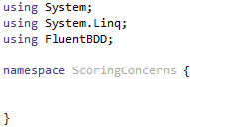
Using FluentBDD
Let’s go back to the bowling alley, this time in code
First, we start with a nice empty code file.
Note “using FluentBDD”

Slide 30
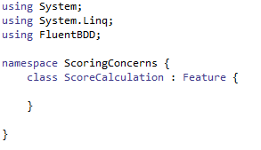
Using FluentBDD
Then we create a class for our feature.
We inherit from “Feature” as that gives us our fluent interface.
The class doesn’t need to be public, but it doesn’t hurt.

Slide 31
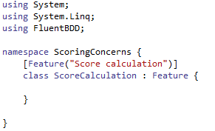
Using FluentBDD
Next, we mark our class as a testable feature, with a name.
The name we give will appear in the unit test results.

Slide 32
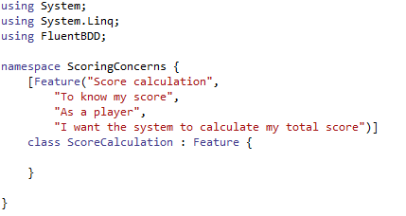
Using FluentBDD
If we’re being good BDD’ers, we will state the stakeholders and reasoning behind our specification.
FluentBDD will let you add as many extra strings to the feature attribute as you like.

Slide 33
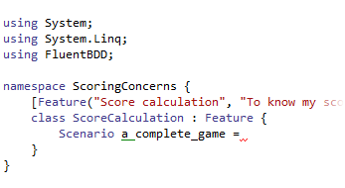
Using FluentBDD
Next, we start a scenario.
The name of the scenario doesn’t matter as long as it’s unique.
If ReSharper greys the scenario out, you can either make it public, or write this at the top of your source file:
#pragma warning disable 169

Slide 34
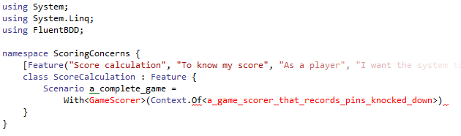
Using FluentBDD
Now we declare our context, with it’s subject type

Slide 35
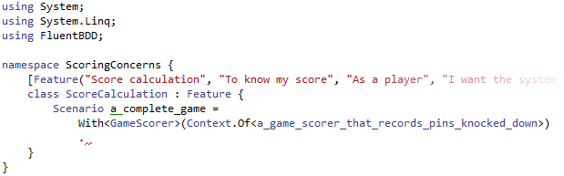
Using FluentBDD
Use ReSharper to generate those classes and we’ll worry about them later.
The compiler may complain until you make your context inherit from “Context<GameScorer>”

Slide 36
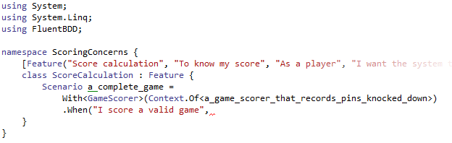
Using FluentBDD
Next, let’s declare our Action.
We give it a plain English name in a string. This will appear in the unit tests.

Slide 37
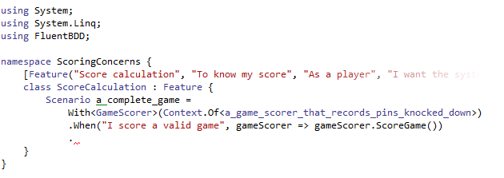
Using FluentBDD
To complete the action, we say what scoring means in code.
We let ReSharper generate the method and we’ll get back to it later.

Slide 38
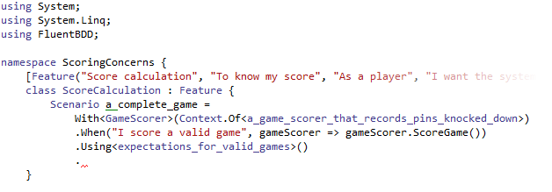
Using FluentBDD
We add in a set of expectations, and let ReSharper create the class.

Slide 39
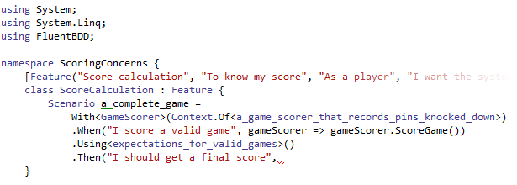
Using FluentBDD
Finally we assert what should happen…

Slide 40
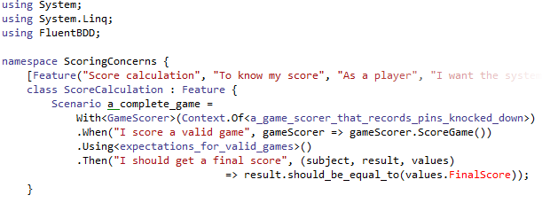
Using FluentBDD
… and explain this in code.
subject is the GameScorer. result is returned from “ScoreGame()”.
values is the instance of our expectations being tested.

Slide 41
Using FluentBDD
We also now have our first red field in our expectations: FinalScore.
We’ll have ReSharper add this and then move on to the context.

Slide 42
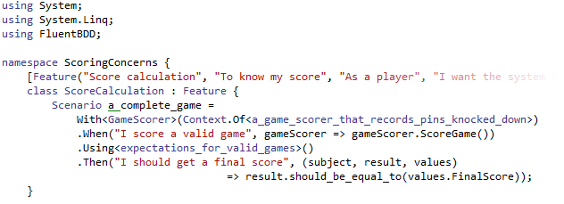
Using FluentBDD
We also now have our first red field in our expectations: FinalScore.
We’ll have ReSharper add this and then move on to the context.

Slide 43
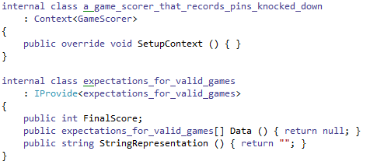
Using FluentBDD
We should have something that looks like this: a Context for a GameScorer class
And a set of expectations that implement IProvide.
Before we start building our context, let’s use our expectations…

Slide 44
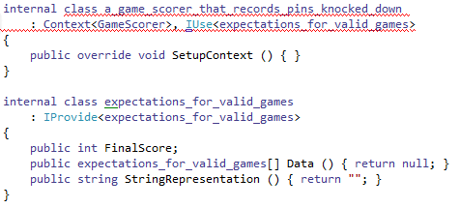
Using FluentBDD
…by adding IUse for our expectations.
Next we need to implement the members of IUse.

Slide 45
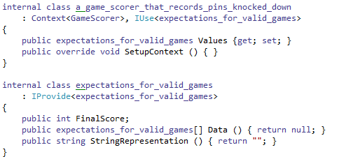
Using FluentBDD
Nice and simple: an auto-property for our expectation class. FluentBDD will inject this at test time.
Now we’re ready to build our context. Start in SetupContext…

Slide 46
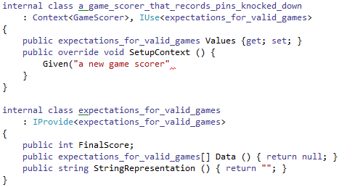
Using FluentBDD
Context gives us the Given() method, which we use to start contexts.
The description we provide will appear in test results.

Slide 47
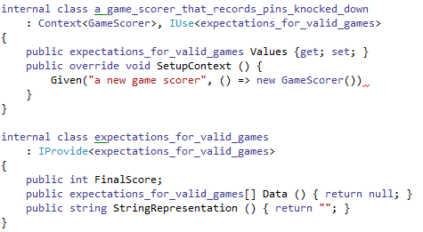
Using FluentBDD
We complete the Given with a code explanation. This must return an instance of the subject.
Our context now needs to interact with the subject, to inject our expectations.

Slide 48
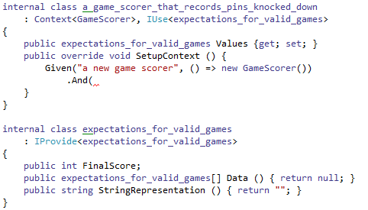
Using FluentBDD
We can add an And to the end of our given…

Slide 49
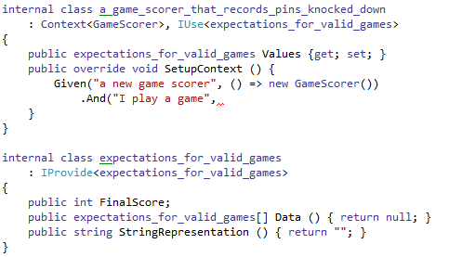
Using FluentBDD
…with a description (which will appear in the tests)…

Slide 50
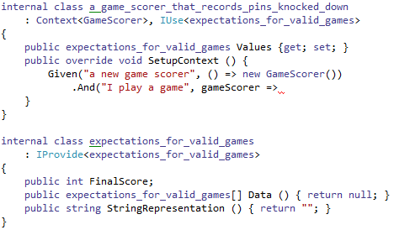
Using FluentBDD
…and a code explanation, which takes the subject we’ve made.

Slide 51
Using FluentBDD
Let’s fill this out with some ‘wish code’

Slide 52
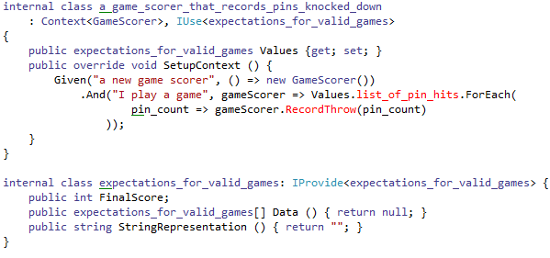
Using FluentBDD
And let ReSharper generate the required parts.

Slide 53
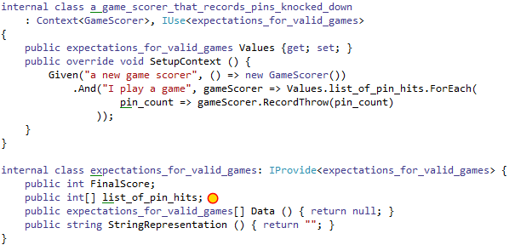
Using FluentBDD
Note the new list of pin hits in our expectations.
You can chain as many .And()s together as you need. Try to keep a balance between number of ands and complexity of the code.

Slide 54
Using FluentBDD
Next, I review my code context to make sure everything is good.
I think the description could be better.

Slide 55
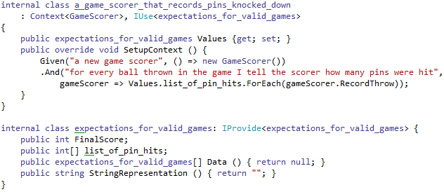
Using FluentBDD
It’s a bit wordy, but much better describes what is happening.
The goal with FluentBDD is clarity, so make sure to review and refactor your specifications like you would with your code.

Slide 56
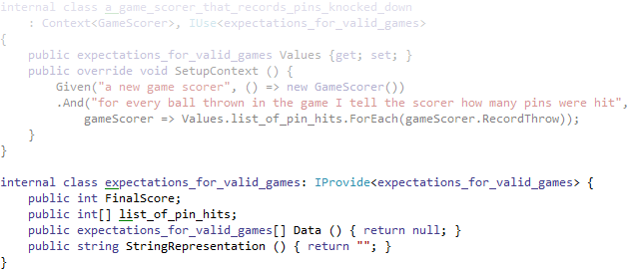
Using FluentBDD
That’s the context complete, now let’s have a look at our expectations.

Slide 57
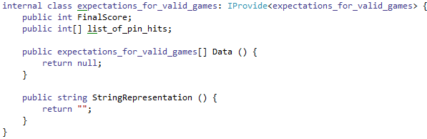
Using FluentBDD
Apart from the public fields we’ve auto-generated from our context and scenario, there are two methods required by IProvide:
Data
and
StringRepresentation

Slide 58
Using FluentBDD
StringRepresentation is used to name each expectation in the unit tests. The name is entirely up to you, but should be enough to identify the test case that has passed or failed.
For now, let’s just show the pin hits and score.

Slide 59
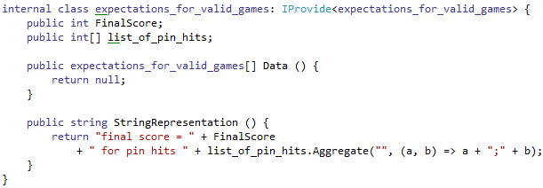
Using FluentBDD
Next, Data returns an array of instances of what we claim to provide.

Slide 60
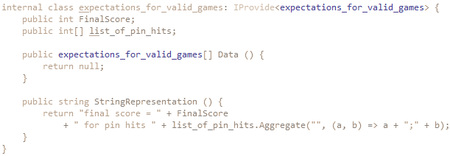
Using FluentBDD
Next, Data returns an array of instances of what we claim to provide.
Note that the return type of Data matches our IProvide type.

Slide 61
Using FluentBDD
For this expectation, we will go the simple route of creating and returning a set of example games.

Slide 62
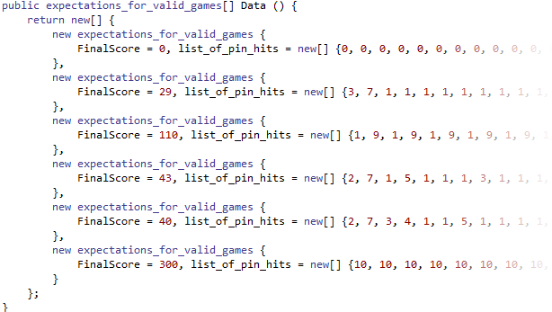
Using FluentBDD
Giving us a Data() method like this.

Slide 63
Using FluentBDD
Now we’ve filled in all the blanks, it’s time to review where we are.

Slide 64
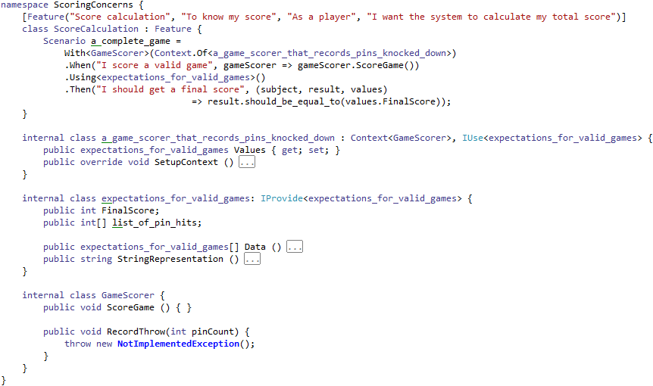
Using FluentBDD
We should have some code that looks like this

Slide 65
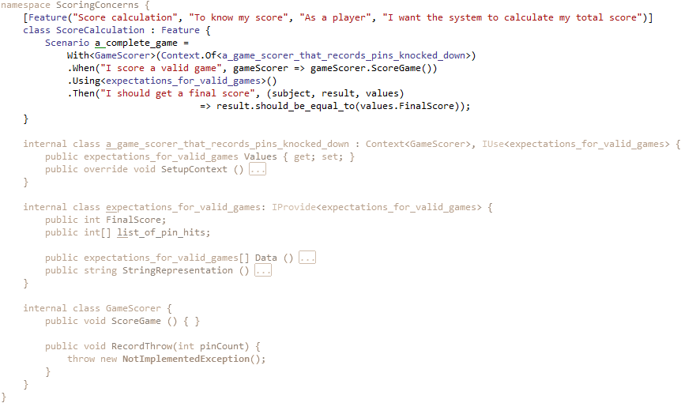
Using FluentBDD
We have a Feature with one Scenario

Slide 66
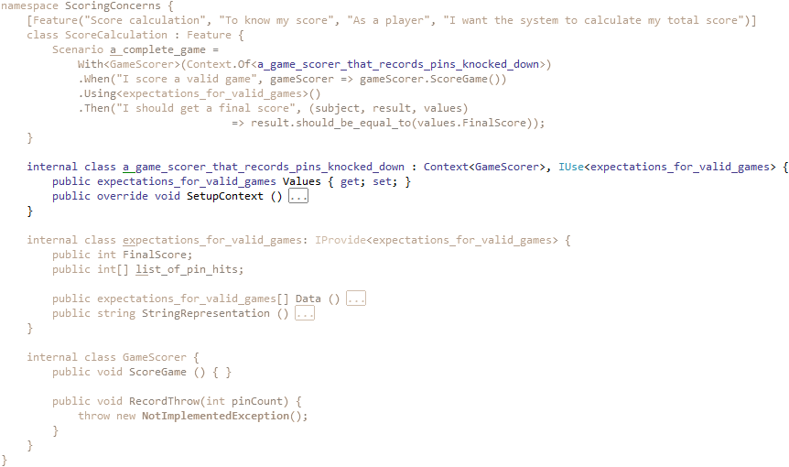
Using FluentBDD
The Scenario has a Context

Slide 67
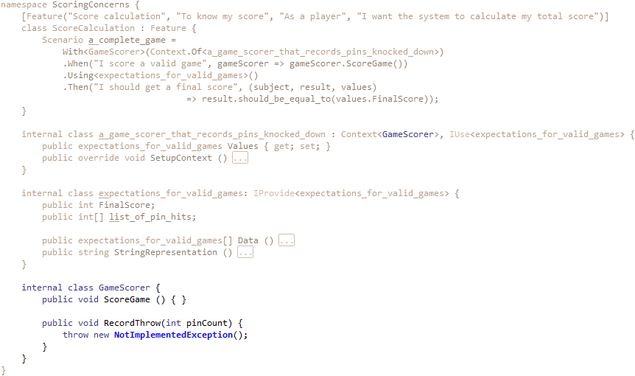
Using FluentBDD
The Context relates to a Subject

Slide 68
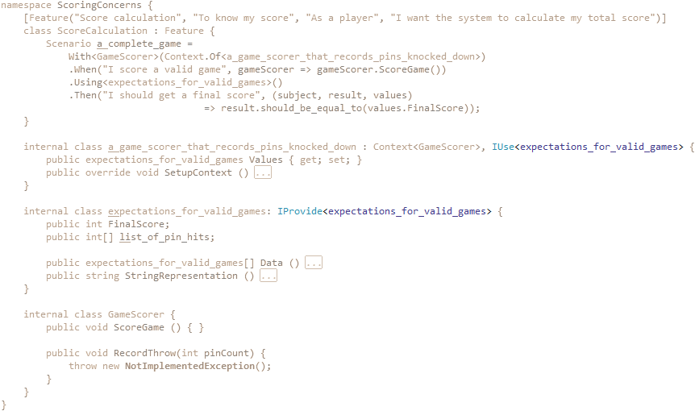
Using FluentBDD
The Context makes use of an Expectation provider type

Slide 69
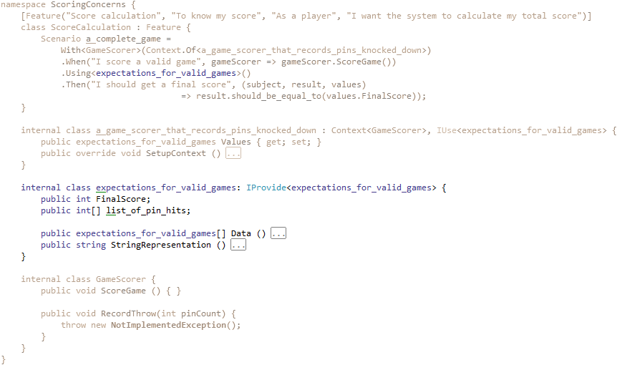
Using FluentBDD
The Scenario ‘uses’ a specific Expectation provider

Slide 70
Using FluentBDD
That’s all we need to run our feature as a set of unit tests. Let’s take a look.

Slide 71
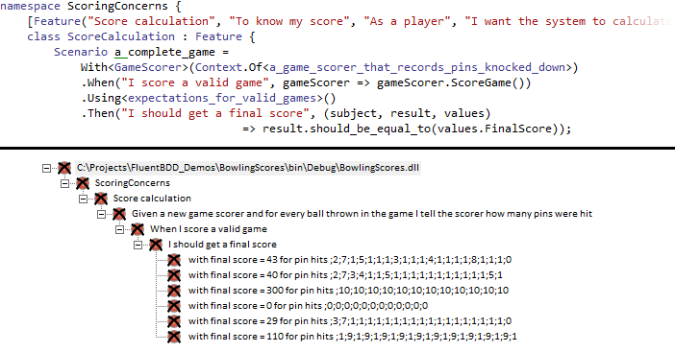
Using FluentBDD
All red, as we should expect – we haven’t implemented GameScorer yet

Slide 72
Using FluentBDD
Notice the progression in the unit tests follows that of the scenario,

Slide 73
Using FluentBDD
And that our one scenario results in six unit tests (one per ‘then’ per expectation)

Slide 74
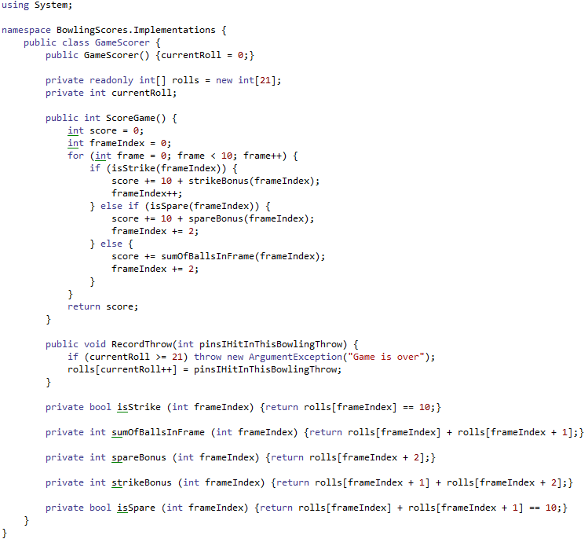
Using FluentBDD
Now if we implement the game scorer…

Slide 75
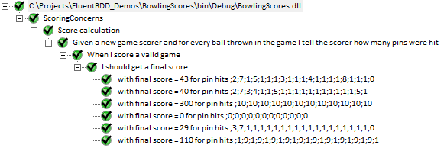
Using FluentBDD
…we are rewarded with a sea of green.

Slide 76
What we want to achieve
Write code that is close to plain English
As little code over-head as possible
Fluent interface
Good conventions for common cases
Type as little as possible
Reusable contexts
Reusable expectations
More than one test per scenario
Good interaction with ReSharper

Slide 77
What we want to achieve
Write code that is close to plain English
As little code over-head as possible
Fluent interface
Good conventions for common cases
Exceptions, Reflection, Creation
Type as little as possible
Reusable contexts
Reusable expectations
More than one test per scenario
Good interaction with ReSharper

Slide 78
Using FluentBDD: Exceptions
If we assumed that we’d never get an invalid call to GameScorer, we’d probably be done now. But reality is rarely so kind.
Let’s build in some range checking. This is part of our Score calculation feature, and will require a new scenario:
Scenario: too many throws
With a game scorer that records pins knocked down
When I ask for the score
Using a game played with too many throws
I should get an exception telling me I’ve thrown too many balls

Slide 79
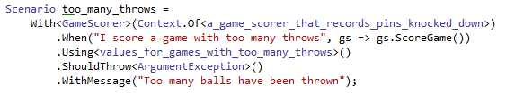
Using FluentBDD: Exceptions
In code we write it like this:
Note, we have no “Then”, but instead we state the scenario should throw a specified type of exception, with an expected message.

Slide 80

Using FluentBDD: Exceptions
If we don’t care about the message returned with the exception, we must state this explicitly.

Slide 81
What we want to achieve
Write code that is close to plain English
As little code over-head as possible
Fluent interface
Good conventions for common cases
Exceptions, Reflection, Creation
Type as little as possible
Reusable contexts
Reusable expectations
More than one test per scenario
Good interaction with ReSharper

Slide 82
Using FluentBDD: Reflection
When dealing with various parts of the .Net ecosystem, class and field attributes can be critically important (e.g. WCF, messaging systems, Automapper)
Scenario: message must be a data contract
With a message object
It should have a “MyMessage” attribute
It should have a “DataContract” attribute
It should have a field “myField” with a “DataMember” attribute and it should be called “PublicName”

Slide 83

Using FluentBDD: Exceptions
In code we write it like this:
Note, we use “Verify” rather than “When”

Slide 84
What we want to achieve
Write code that is close to plain English
As little code over-head as possible
Fluent interface
Good conventions for common cases
Exceptions, Reflection, Creation
Type as little as possible
Reusable contexts
Reusable expectations
More than one test per scenario
Good interaction with ReSharper

Slide 85
Using FluentBDD: Creation
A lot of guard exceptions are placed around the creation of classes. There are a few other cases where we won’t have a pre-made context or subject
Feature: Calculator creation
Scenario: creating a calculator
When I create a calculator
I should get an non-null object
Scenario: creating a calculator with invalid parameters
When I create a calculator with a null delegate
I should get an argument exception
With message “A delegate must be provided”

Slide 86
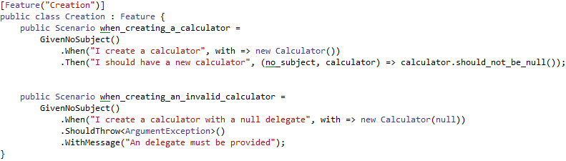
Using FluentBDD: Exceptions
In code we write it like this:

Slide 87
What we want to achieve
Write code that is close to plain English
As little code over-head as possible
Fluent interface
Good conventions for common cases
Exceptions, Reflection, Creation
Type as little as possible
Reusable contexts
Reusable expectations
More than one test per scenario
Good interaction with ReSharper

Slide 88
Fluent BDD
Advanced topics: Templating

Slide 89
Advanced FluentBDD: Templating
When we write a specification template, we are trying to achieve one of two goals:
Supply different sets of Expectations to the same Context for multiple Scenarios
We do this when we expect different outcomes from a scenario based solely on differing input.
Expecting different subjects to have the same behaviour
For example, different implementations of an interface or two features which have scenarios in common
The for the first case, we head back to the bowling alley…

Slide 90
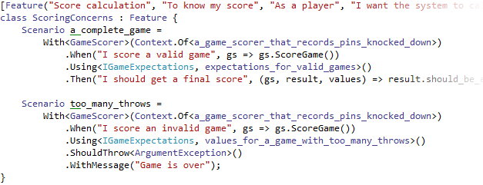
Advanced FluentBDD: Templating
Here we have our scoring feature, with two scenarios.

Slide 91
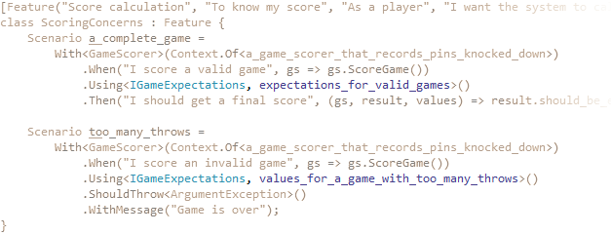
Advanced FluentBDD: Templating
Note the “Using” clause now has both an interface name and an implementation name.

Slide 92
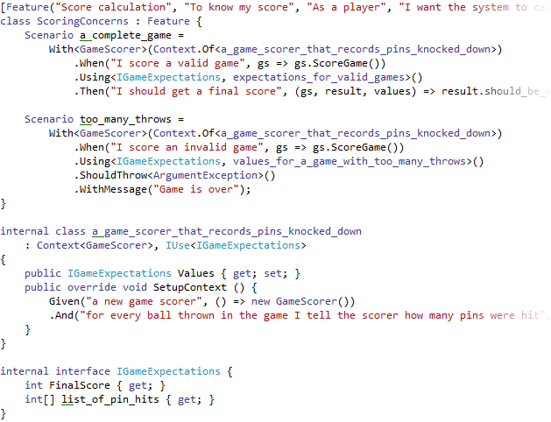
Advanced FluentBDD: Templating
The context has a normal subject, and implements the IUse interface.

Slide 93
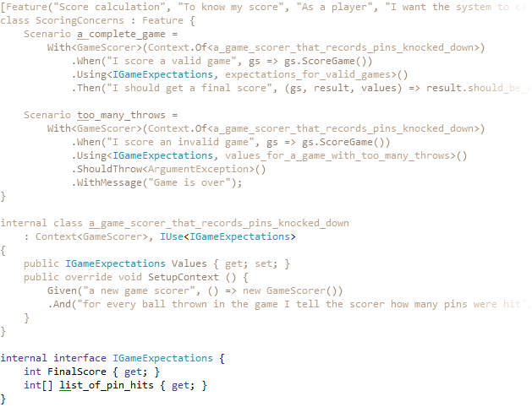
Advanced FluentBDD: Templating
The IGameExpectations interface provides the expectations used in the context and assertions, with no references to concretes outside of “Using”

Slide 94
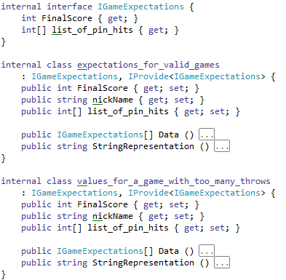
Advanced FluentBDD: Templating
The concrete expectations implement both the IGameExpectations interface and the IProvide interface.

Slide 95
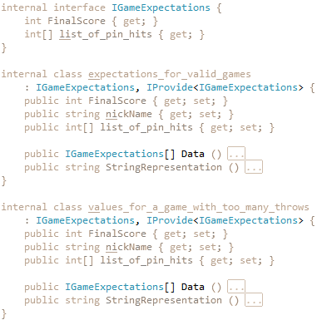
Advanced FluentBDD: Templating
Note that it’s the IGameExpectations interface that is being provided…

Slide 96
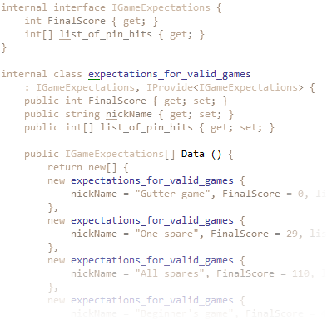
Advanced FluentBDD: Templating
…but instances of the concrete are being returned.

Slide 97
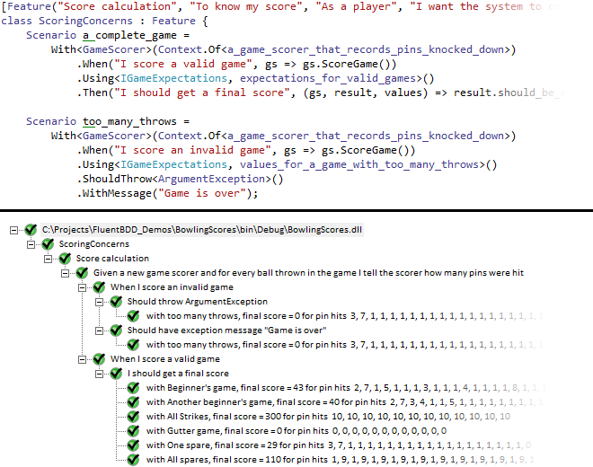
Advanced FluentBDD: Templating
Notice that the test results have only one “Given”, but two “When”s

Slide 98
Advanced FluentBDD: Templating
Next, let’s look at the case of allowing generic subjects to a feature

Slide 99
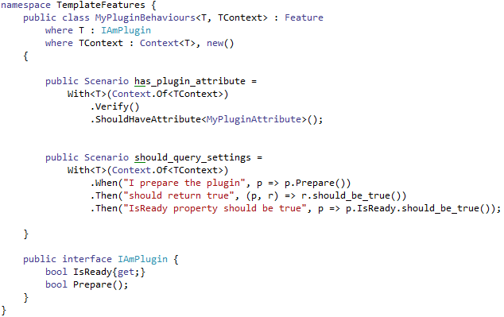
Advanced FluentBDD: Templating
Here we have a class which inherits from Feature, but does not have the Feature attribute. This class will not generate tests.

Slide 100
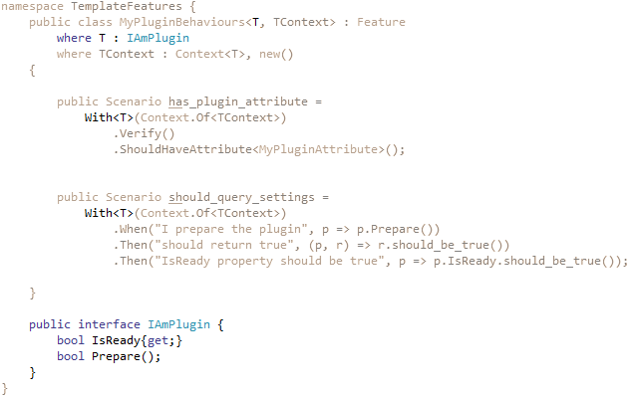
Advanced FluentBDD: Templating
We specify a Subject type parameter, and an interface it must implement

Slide 101

Advanced FluentBDD: Templating
We specify a Context type parameter, with the restriction that it must be a Context of the subject, and that it is new-able.
(We could create our own internal context if we wanted)

Slide 102

Advanced FluentBDD: Templating
The Scenarios are public, to ensure they can be inherited.

Slide 103

Advanced FluentBDD: Templating
To test a specific subject, we need to supply a context and subject.
Note that the feature specifies no scenarios of it’s own…

Slide 104

Advanced FluentBDD: Templating
…but still produces a healthy shade of green.

Slide 105

Advanced FluentBDD: Templating
We can supply as many template-based features as we like…

Slide 106

Advanced FluentBDD: Templating
…and can add extra scenarios if we want.

Slide 107
Advanced FluentBDD: Templating
There are more advanced examples, and demonstrations of different usage in the UsageExamples project of the FluentBDD solution.

Slide 108
What we want to achieve
Write code that is close to plain English
As little code over-head as possible
Fluent interface
Good conventions for common cases
Exceptions, Reflection, Creation
Type as little as possible
Reusable contexts
Reusable expectations
More than one test per scenario
Good interaction with ReSharper

Slide 109
Fluent BDD
any questions?
FluentBDD is a work in progress, and will most likely expand as it is used more extensively.

